Slide 1






DETECTING PNEUMONIA IN CHEST X-RAYS
Saad raees
Muhammad qayyum

Slide 2
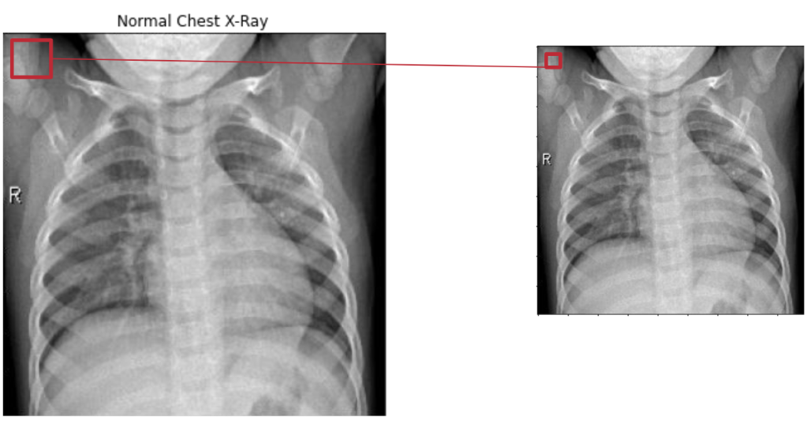
What is Pneumonia
An acute respiratory infection that affects the lungs.
About 1 million adults in the US seek hospital care due to pneumonia every year and about 50,000 die from this disease according to the American Thoracic Society.

Slide 3
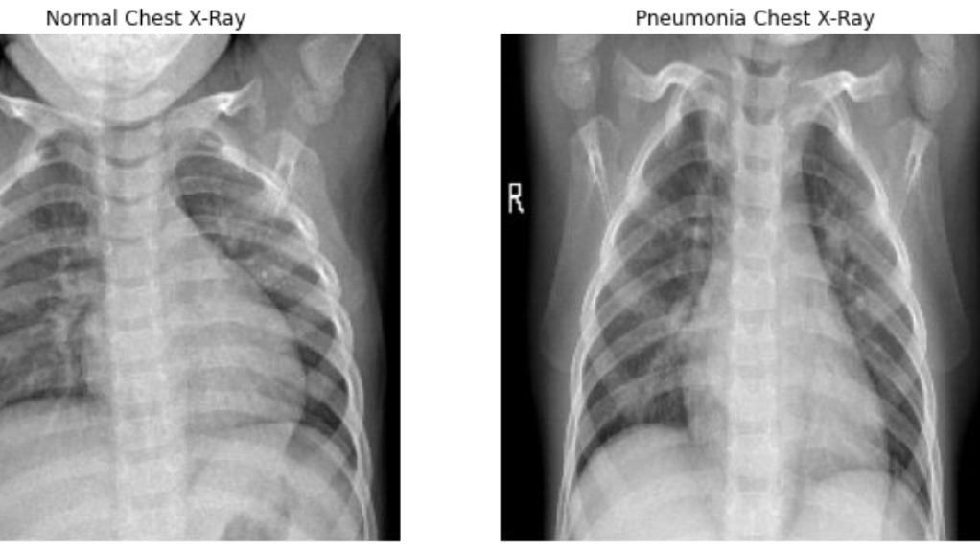
Reading Chest X-Rays

Slide 4
What is Convulutional Neural Network

Slide 5
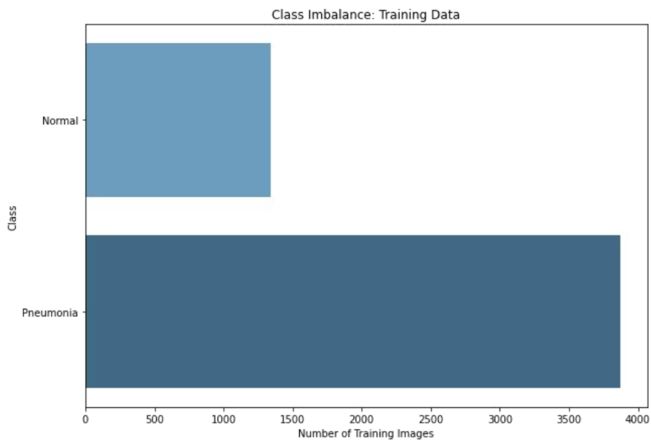
The Challenge

Slide 6
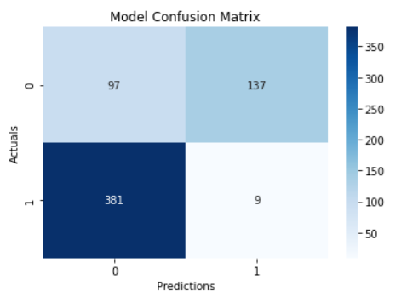
The Results
We want to reduce false negatives and false positives
Overall accuracy is 82%

Slide 7
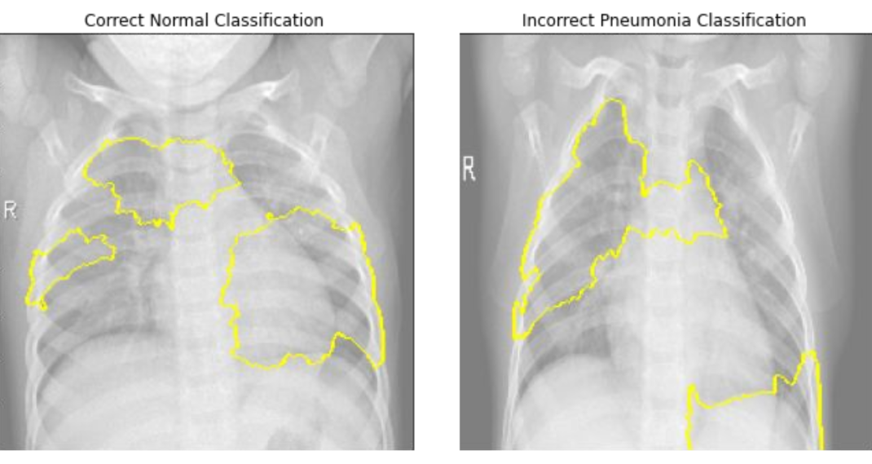
The Results

Slide 8
Recommendations
Use the CNN model to improve efficiency.
CNN Makes Prediction
Tech/Doc Revies CNN Prediction
Tech/Doc Makes Final Prediction.

Slide 9
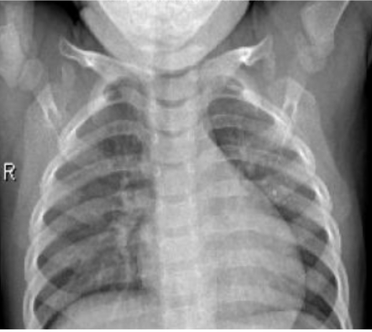
RECOMMENDATIONS
Ask tech to crop out diaphragm before feeding into the model
Save images as 224 x 224 pixels before uploading to the model

Slide 10
FUTURE WORK
Pre-processing:
Remove Diaphragm
Make Images Smaller
Fine Tuning:
Unfreezing certain layers of transfer-learning base
More Research:
Research more successful tuning methods

Slide 11
THANKS!
Any Questions?
SAAD RAEES
MUHAMMAD QAYYUM

Slide 12
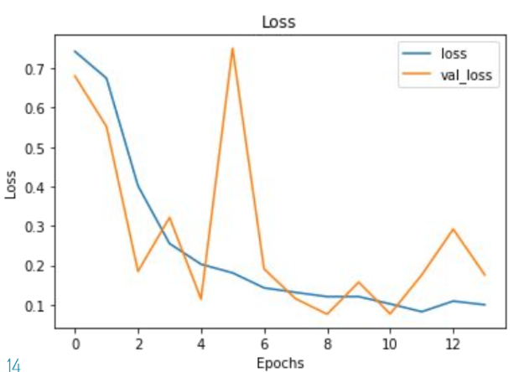
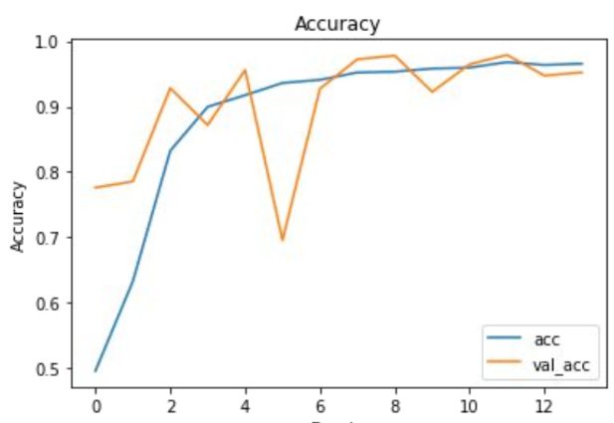
Appendix: Model Validation

